Slide 1
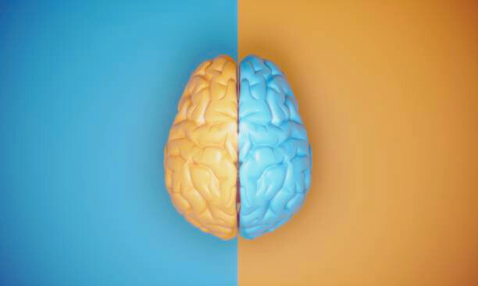
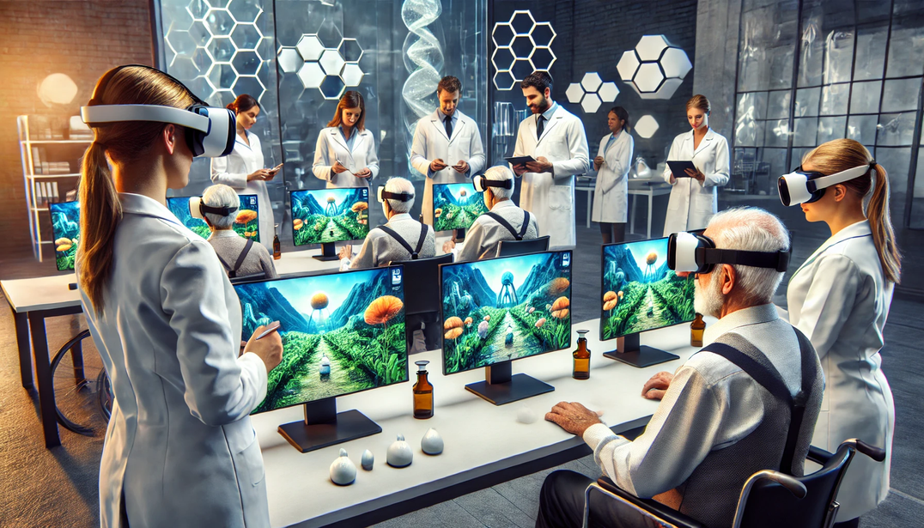
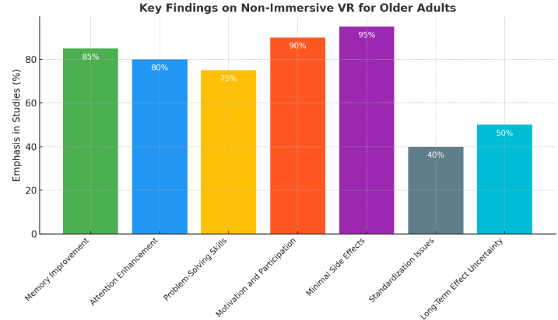
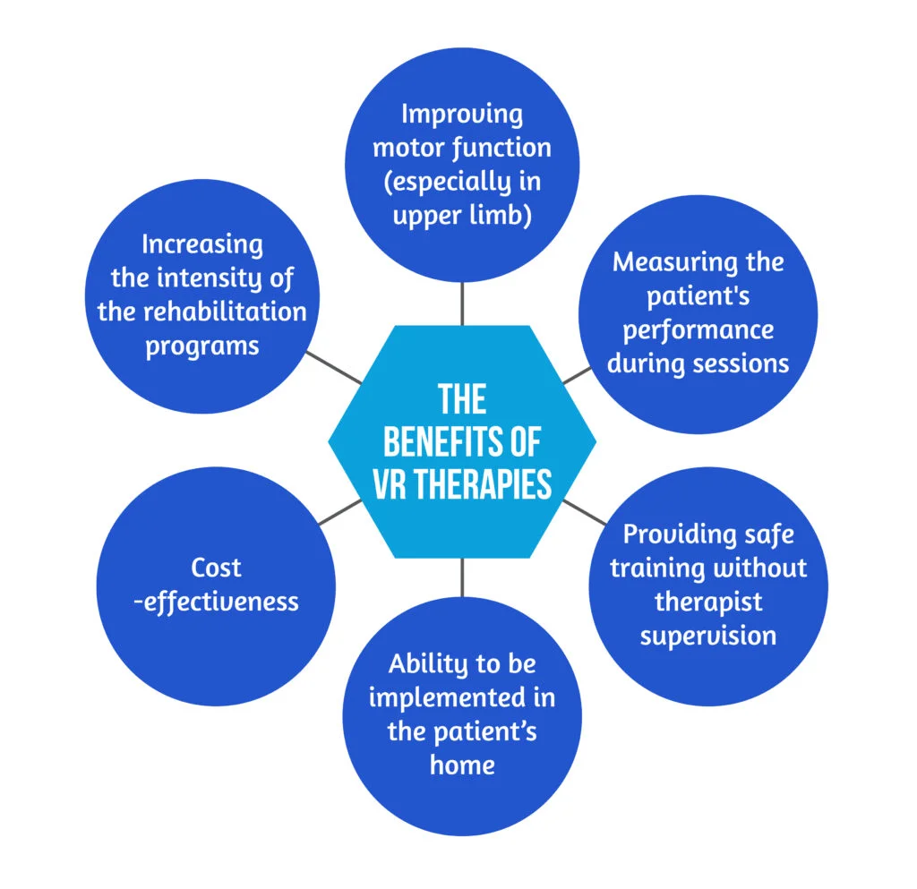
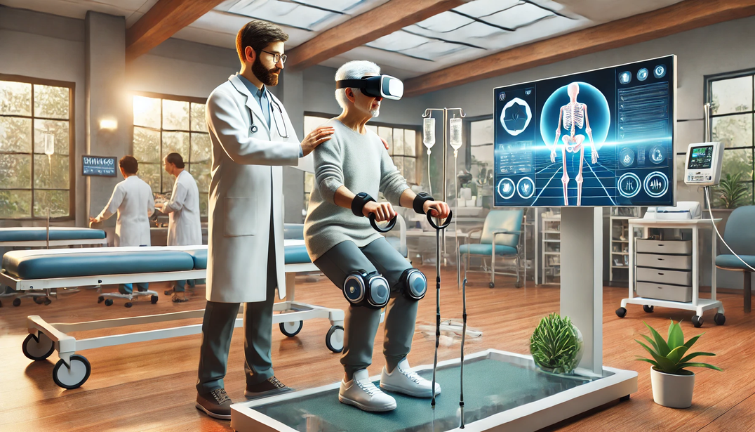
NON IMMERSIVE VIRTUAL REALITY IN IMPROVING EXECUTIVE FUNCTIONS IN OLDER ADULTS - A LITERATURE REVIEW
Background
OLDER ADULTS ARE A VALUABLE RESOURCE, YET THE AGING POPULATION IN INDIA IS EXPECTED TO GROW FROM 138 MILLION IN 2021 TO 194 MILLION BY 2031, POSING SIGNIFICANT PUBLIC HEALTH CHALLENGES. AGING LEADS TO A DECLINE IN EXECUTIVE FUNCTIONS—KEY SKILLS SUCH AS INHIBITION, FLEXIBILITY, PLANNING, AND WORKING MEMORY—ESSENTIAL FOR DAILY LIVING. IMPAIRMENTS IN THESE FUNCTIONS CORRELATE WITH DECREASED QUALITY OF LIFE AND INCREASED DEPENDENCY.VIRTUAL REALITY (VR) IS A PROMISING TOOL IN REHABILITATION, USING INTERACTIVE SIMULATIONS TO ENHANCE COGNITIVE AND PHYSICAL SKILLS WHILE IMPROVING EMOTIONAL WELL-BEING AND MOTIVATION. NON-IMMERSIVE VR, DELIVERED VIA SCREENS OR PROJECTORS, IS PARTICULARLY SUITABLE FOR OLDER ADULTS DUE TO ITS ACCESSIBILITY AND MINIMAL SIDE EFFECTS, SUCH AS CYBER SICKNESS, COMMONLY SEEN WITH IMMERSIVE VR.ALTHOUGH NON-IMMERSIVE VR HAS SHOWN POTENTIAL FOR IMPROVING COGNITION AND EXECUTIVE FUNCTIONS, ITS EFFECTS HAVE NOT BEEN COMPREHENSIVELY ANALYZED.
OBJECTIVE
TO REVIEW THE EFFECTIVENESS OF NON-IMMERSIVE VIRTUAL REALITY IN ENHANCING EXECUTIVE FUNCTIONS IN OLDER ADULTS AND IDENTIFY RESEARCH GAPS FOR FUTURE EXPLORATION.
Key Findings
NON-IMMERSIVE VIRTUAL REALITY (VR) HAS SHOWN PROMISING RESULTS IN IMPROVING EXECUTIVE FUNCTIONS SUCH AS MEMORY, ATTENTION, AND PROBLEM-SOLVING IN OLDER ADULTS. STUDIES HIGHLIGHT THAT THIS APPROACH IS WELL-ACCEPTED DUE TO ITS MINIMAL SIDE EFFECTS COMPARED TO IMMERSIVE VR, WHICH OFTEN CAUSES NAUSEA AND DIZZINESS. NON-IMMERSIVE VR INTERVENTIONS ENHANCE MOTIVATION AND PARTICIPATION THROUGH FEATURES LIKE IMMEDIATE FEEDBACK AND ENGAGING, GOAL-ORIENTED TASKS. HOWEVER, THE LACK OF STANDARDIZED PROTOCOLS AND LIMITED LONGITUDINAL STUDIES RESTRICTS THE GENERALIZABILITY OF THESE FINDINGS. ADDITIONALLY, WHILE SOME STUDIES EMPHASIZE IMPROVED COGNITIVE PERFORMANCE, OTHERS SUGGEST FURTHER RESEARCH IS NEEDED TO EXPLORE LONG-TERM EFFECTS AND OPTIMIZE INTERVENTION STRATEGIES.
Methodology
A SYSTEMATIC SEARCH WAS CONDUCTED ACROSS DATABASES INCLUDING PUBMED, SCOPUS, AND GOOGLE SCHOLAR. KEYWORDS SUCH AS “NON-IMMERSIVE VIRTUAL REALITY,” “EXECUTIVE FUNCTIONS,” “OLDER ADULTS,” AND “COGNITIVE REHABILITATION” WERE USED TO IDENTIFY RELEVANT STUDIES. THE INCLUSION CRITERIA FOCUSED ON STUDIES INVOLVING OLDER ADULTS (60+ YEARS) USING NON-IMMERSIVE VR INTERVENTIONS TARGETING EXECUTIVE FUNCTIONS LIKE MEMORY, ATTENTION, PLANNING, AND FLEXIBILITY. STUDIES ON IMMERSIVE VR WITH REPORTED SIDE EFFECTS, NON-ENGLISH PUBLICATIONS, AND RESEARCH NOT FOCUSED ON COGNITIVE OUTCOMES WERE EXCLUDED.
Data was extracted on participant demographics, VR intervention specifics (e.g., duration, frequency, and mode), and outcomes related to executive functions. Studies were analyzed to evaluate the effectiveness of non-immersive VR in improving cognition and participation among older adults, while identifying gaps for future research.
Conclusion
NON-IMMERSIVE VIRTUAL REALITY IS AN EMERGING, SAFE, AND EFFECTIVE TOOL FOR IMPROVING EXECUTIVE FUNCTIONS IN OLDER ADULTS. IT ENHANCES COGNITIVE ABILITIES, MOTIVATION, AND QUALITY OF LIFE WHILE BEING WELL-TOLERATED. HOWEVER, FURTHER RESEARCH IS REQUIRED TO STANDARDIZE INTERVENTIONS AND ANALYZE LONG-TERM BENEFITS COMPREHENSIVELY.
Discussion
NON-IMMERSIVE VIRTUAL REALITY (VR) HAS EMERGED AS A PROMISING TOOL FOR COGNITIVE REHABILITATION IN OLDER ADULTS, PARTICULARLY IN ENHANCING EXECUTIVE FUNCTIONS. STUDIES HIGHLIGHT ITS EFFECTIVENESS IN IMPROVING COGNITIVE DOMAINS SUCH AS MEMORY, ATTENTION, AND FLEXIBILITY, WHILE ALSO PROMOTING MOTIVATION AND PARTICIPATION THROUGH INTERACTIVE AND GOAL-ORIENTED TASKS. UNLIKE IMMERSIVE VR, NON-IMMERSIVE VR MINIMIZES ADVERSE EFFECTS LIKE CYBER SICKNESS, MAKING IT MORE ACCEPTABLE FOR OLDER POPULATIONS. THE MECHANISM OF IMPROVEMENT IS LINKED TO NEURAL ACTIVATION IN PATHWAYS SUCH AS THE CHOLINERGIC AND DOPAMINERGIC SYSTEMS, FOSTERING COGNITIVE ENGAGEMENT.
However, current research faces limitations, including variability in study designs, small sample sizes, and the absence of standardized protocols for interventions. Longitudinal studies are scarce, leaving questions about the sustainability of these improvements. Addressing these gaps is crucial to fully integrate non-immersive VR into evidence-based rehabilitation programs for older adults.

